Slide 1
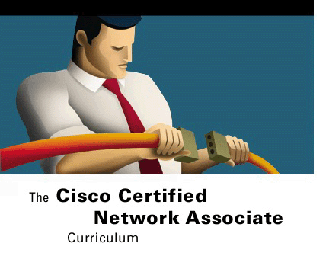



WANs AND ROUTERs
Routing and Router Basics
Version 3.0
Cisco Regional Networking Academy

Slide 2
Objectives
An overview of WAN technologies and protocols.
A close examination of the internal and external physical components of the router.

Slide 3
Table of Content
1 | WANs
2 | Router

Slide 4

WANs

Slide 5
Introduction to WANs
Operate over large geographical area
Exchange data packets/frames between inter-connected LANs
Use the services of carriers (Telco)
Full-time or part-time connectivity
Operate at Physical and Data link layers
Use serial connections
Notes:
Introduction to WANs
A wide-area network (WAN) is a data communications network spanning a large geographic area such as a state, province, or country. WANs often use transmission facilities provided by common carriers, for example, telephone companies.
These are the major characteristics of WANs:
They connect devices that are separated by wide geographical areas.
They use the services of carriers such as the Regional Bell Operating Companies (RBOCs), Sprint, MCI, VPM Internet Services, Inc., and Altantes.net.
They use serial connections of various types to access bandwidth over large geographic areas.
A WAN differs from a LAN in several ways. For example, unlike a LAN, which connects workstations, peripherals, terminals, and other devices in a single building or other small geographic area, a WAN makes data connections across a broad geographic area. Companies use a WAN to connect various company sites so that information can be exchanged between distant offices.
A WAN operates at the physical layer and the data link layer of the OSI reference model. It interconnects LANs that are usually separated by large geographic areas. WANs provide for the exchange of data packets and frames between routers and switches and the LANs they support.

Slide 6
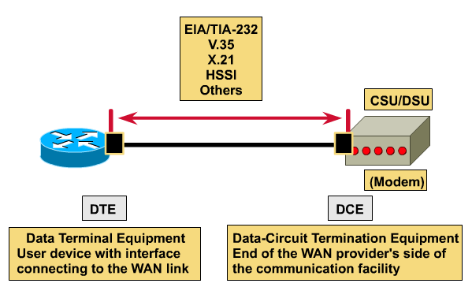
WAN devices
Router
Switch
Modem
Communication server
Notes:
See 1.1.1
The following devices are used in WANs:
Routers offer many services, including internetworking and WAN interface ports.
Switches in the WAN provide connectivity for voice, data, and video communication.
Modems include interface voice-grade services, channel service units/digital service units (CSU/DSUs) that interface T1/E1 services, and Terminal Adapters/Network Termination 1 (TA/NT1s) that interface Integrated Services Digital Network (ISDN) services.
Communication servers concentrate dial-in and dial-out user communication.

Slide 7
WANs standards and protocols
Physical
Modem or CSU/DSU
Modem or CSU/DSU
Router
Router
Data Link
WAN physical layer protocols describe how to provide electrical, mechanical, operational, and functional connections for WAN services
WAN data link protocols describe how frames are carried between systems on a single data link.
Notes:
See 1.1.4
WAN is said to operate at the physical layer and at the data link layer. This does not mean that the other five layers of the OSI model are not found in a WAN. It simply means that the characteristics that separate a WAN from a LAN are typically found at the physical layer and the data link layer. In other words, the standards and protocols used in WANs at Layer 1 and Layer 2 are different from those used in LANs at the same layers.
The WAN physical layer describes the interface between the data terminal equipment (DTE) and the data circuit-terminating equipment (DCE). Generally, the DCE is the service provider and the DTE is the attached device. In this model, the services offered to the DTE are made available through a modem or a CSU/DSU.
some of the key WAN protocols and standards are listed here for reference.
WAN physical layer standards and protocols:
EIA/TIA-232
EIA/TIA-449
V.24
V.35
X.21
G.703
EIA-530
ISDN
T1, T3, E1, and E3
xDSL
SONET (OC-3, OC-12, OC-48, OC-192)
WAN data link layer standards and protocols:
High-level data link control (HDLC)
Frame Relay
Point-to-Point Protocol (PPP)
Synchronous Data Link Control (SDLC)
Serial Line Internet Protocol (SLIP)
X.25
ATM
LAPB
LAPD
LAPF

Slide 8
WANs standards and protocols
EIA/TIA-232, V.35, X.21, HSSI…
Modem or CSU/DSU
Router
HDLC – High-level Data Link Control
Frame Relay
ISDN – Integrated Service Digital Network
PPP – Point-to-Point Protocol
DTE
Data Terminal Equipment
User device with interface connecting to the WAN link
DCE
Data-Circuit Terminating Equipment
End of the WAN provider’s side of the communication facility
Notes:
See 1.1.4
WAN is said to operate at the physical layer and at the data link layer. This does not mean that the other five layers of the OSI model are not found in a WAN. It simply means that the characteristics that separate a WAN from a LAN are typically found at the physical layer and the data link layer. In other words, the standards and protocols used in WANs at Layer 1 and Layer 2 are different from those used in LANs at the same layers.
The WAN physical layer describes the interface between the data terminal equipment (DTE) and the data circuit-terminating equipment (DCE). Generally, the DCE is the service provider and the DTE is the attached device. In this model, the services offered to the DTE are made available through a modem or a CSU/DSU.
some of the key WAN protocols and standards are listed here for reference.
WAN physical layer standards and protocols:
EIA/TIA-232
EIA/TIA-449
V.24
V.35
X.21
G.703
EIA-530
ISDN
T1, T3, E1, and E3
xDSL
SONET (OC-3, OC-12, OC-48, OC-192)
WAN data link layer standards and protocols:
High-level data link control (HDLC)
Frame Relay
Point-to-Point Protocol (PPP)
Synchronous Data Link Control (SDLC)
Serial Line Internet Protocol (SLIP)
X.25
ATM
LAPB
LAPD
LAPF

Slide 9
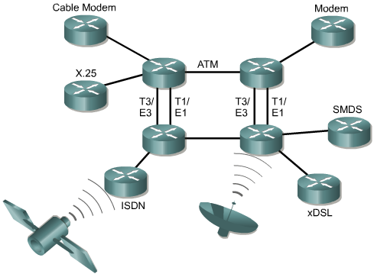
Router LANs and WANs
Notes:
See 1.1.3, 1.1.4
A router can be used to segment LANs, its also use is as a WAN device. Routers have both LAN and WAN interfaces.
The two main functions of a router are the selection of best path for and the switching of frames to the proper interface.
The primary WAN roles of a router are providing connections to and between the various WAN physical and data-link standards. For example, a router may have an ISDN interface using PPP encapsulation and a serial interface terminating a T1 line using Frame Relay encapsulation. The router must be able to move a stream of bits from one type of service, such as ISDN, to another, such as a T1, and change the data link encapsulation from PPP to Frame Relay.

Slide 10
ROUTERS

Slide 11
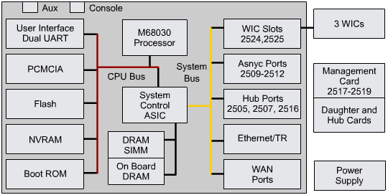
Router internal components
Notes:
See 1.2.1
CPU – The Central Processing Unit (CPU) executes instructions in the operating system. Among these functions are system initialization, routing functions, and network interface control.
RAM – Random-access memory (RAM) is used for routing table information, fast switching cache, running configuration, and packet queues. In most routers the RAM provides run time space for executable Cisco IOS software and its subsystems. RAM is usually logically divided into main processor memory and shared input/output (I/O) memory. Shared I/O memory is shared among interfaces for temporary storage of packets. The contents of RAM are lost when power is removed. RAM is generally dynamic random-access memory (DRAM) and can be upgraded by adding additional Dual In-Line Memory Modules (DIMMs).
Flash – Flash memory is used for storage of a full Cisco IOS software image. The router normally acquires the default IOS from flash. These images can be upgraded by loading a new image into flash.
NVRAM – Nonvolatile random-access memory (NVRAM) is used to store the startup configuration. In other devices it is implemented in the same flash device from which the boot code is loaded. In either case these devices retain contents when power is removed.
Buses – Most routers contain a system bus and a CPU bus.
The system bus is used for communication between the CPU and the interfaces and/or expansion slots. This bus transfers the packets to and from the interfaces.
The CPU bus is used by the CPU for accessing components from router storage. This bus transfers instructions and data to or from specified memory addresses.
ROM – Read-only memory (ROM) is used for permanently storing startup diagnostic code (ROM Monitor). The main tasks for ROM are hardware diagnostics during router bootup and loading the Cisco IOS software from flash to RAM. Some routers also have a scaled down version of the IOS that can be used as an alternative boot source. ROMs are not erasable. They can only be upgraded by replacing the ROM chips in the sockets.
Power Supply – The power supply provides the necessary power to operate the internal components.
Interfaces – The interfaces are the router connections to the outside. The three types of interfaces are local-area network (LANs), wide-area network (WANs), and Console/AUX.

Slide 12
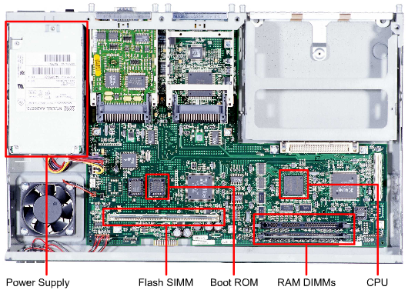
Router physical characteristics
Notes:
Router physical characteristics It is not critical to know the location of the physical components inside the router to understand how to use the router. However in some situations, such as adding memory, it can be very helpful. The exact components used and their location varies between router models. Figure identifies the internal components of a 2600 router

Slide 13
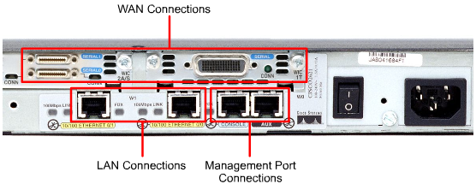
Router external connections
Notes:
See 1.2.3
The three basic types of connections on a router are LAN interfaces, WAN interfaces, and management ports.
LAN interfaces allow the router to connect to the Local Area Network media. This is usually some form of Ethernet. However, it could be some other LAN technology such as Token Ring or Asynchronous Transfer Mode (ATM).
Wide Area Network connections provide connections through a service provider to a distant site or to the Internet. These may be serial connections or any number of other WAN interfaces. With some types of WAN interfaces, an external device such as a CSU is required to connect the router to the local connection of the service provider. With other types of WAN connections, the router may be directly connected to the service provider.
The management port provides a text-based connection for the configuration and troubleshooting of the router. The common management interfaces are the console and auxilliary ports. These are EIA-232 asynchronous serial ports. They are connected to a communications port on a computer. The computer must run a terminal emulation program to provide a text-based session with the router. Through this session the network administrator can manage the device.

Slide 14
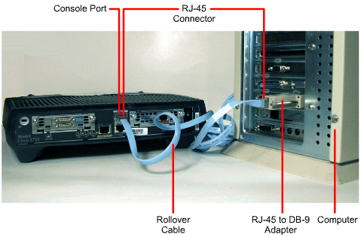
Connecting console interfaces
Notes:
See 1.2.4, 1.2.5

Slide 15
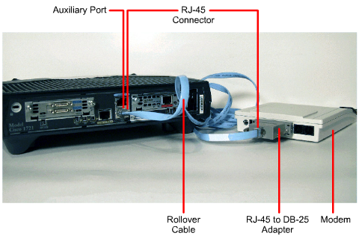
Connecting AUX interfaces
Notes:
See 1.2.4

Slide 16
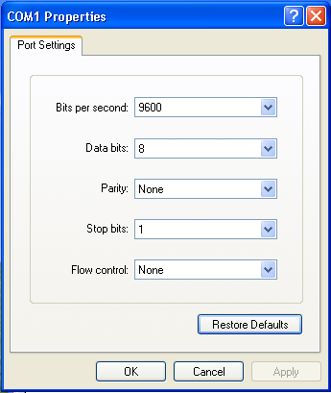
HyperTerminal session properties
Notes:
See 1.2.5

Slide 17
Connecting LAN interfaces
From an Ethernet/FastEthernet interface to a hub/switch: straight – through cable
From an Ethernet/FastEthernet interface to a PC/other Router: crossover cable.
Notes:
See 1.2.6

Slide 18
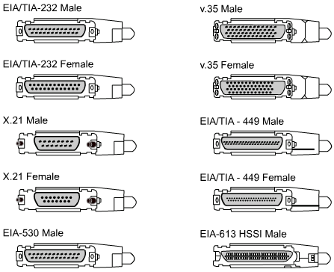
Connecting WAN interfaces
Notes:
For each type of WAN service, the customer premises equipment (CPE), often a router, is the data terminal equipment (DTE). This is connected to the service provider using a data circuit-terminating equipment (DCE) device, commonly a modem or channel service unit/data service unit (CSU/DSU). This device is used to convert the data from the DTE into a form acceptable to the WAN service provider.

Slide 19

Summary
WAN and LAN concepts
Role of a router in WANs and LANs
The identification and description of the internal components of a router
How to connect router console, LAN, and WAN ports

Slide 20

Q&A
Notes:
_________________________________________________________________________
_________________________________________________________________________
_________________________________________________________________________
_________________________________________________________________________
_________________________________________________________________________
_________________________________________________________________________
_________________________________________________________________________
_________________________________________________________________________
_________________________________________________________________________
_________________________________________________________________________
_________________________________________________________________________
_________________________________________________________________________
_________________________________________________________________________
_________________________________________________________________________
_________________________________________________________________________
_________________________________________________________________________
_________________________________________________________________________
_________________________________________________________________________
_________________________________________________________________________

Slide 21
Enjoy the Course
Notes:
_________________________________________________________________________
_________________________________________________________________________
_________________________________________________________________________
_________________________________________________________________________
_________________________________________________________________________
_________________________________________________________________________
_________________________________________________________________________
_________________________________________________________________________
_________________________________________________________________________
_________________________________________________________________________
_________________________________________________________________________
_________________________________________________________________________
_________________________________________________________________________
_________________________________________________________________________
_________________________________________________________________________
_________________________________________________________________________
_________________________________________________________________________
_________________________________________________________________________
_________________________________________________________________________

